Slide 1
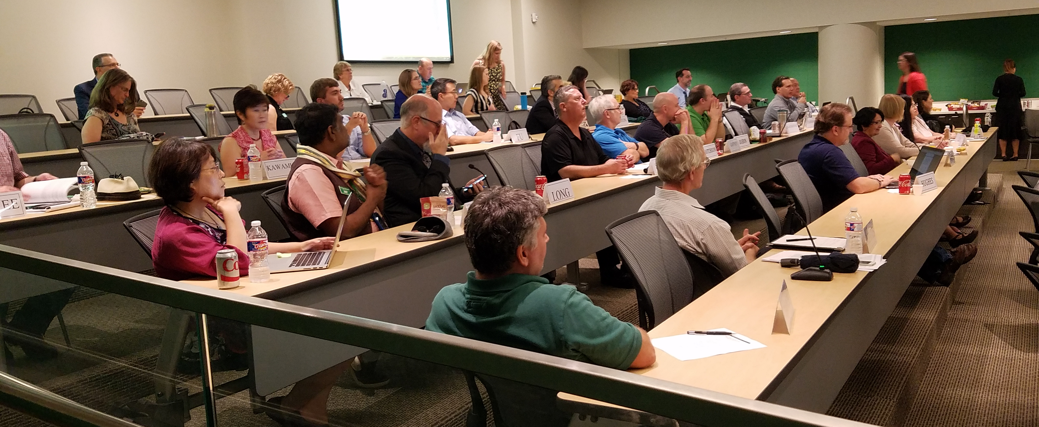
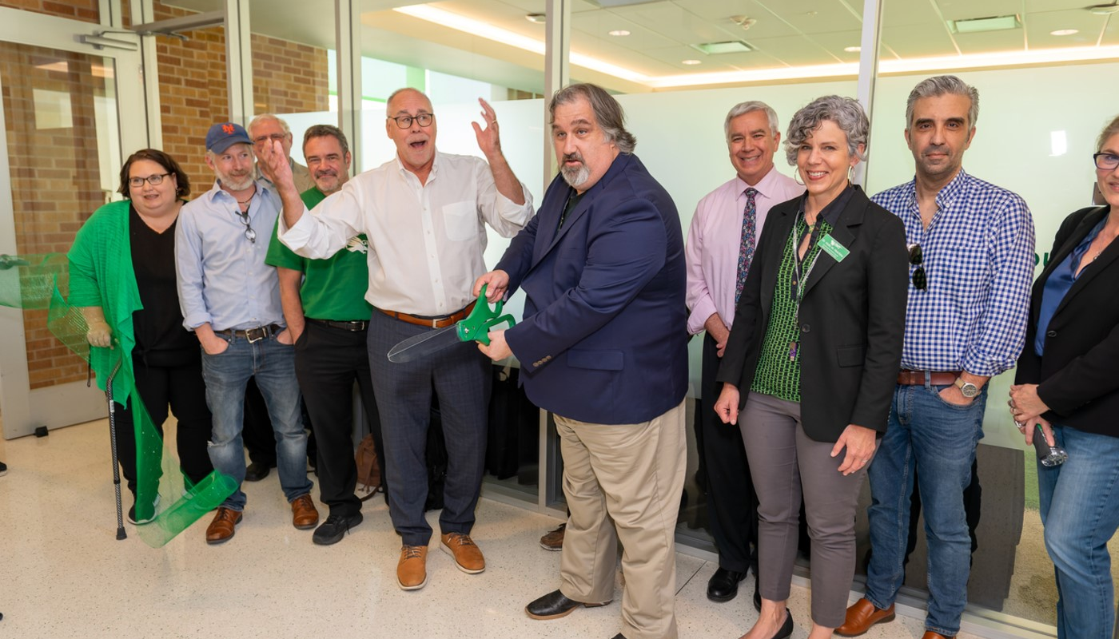


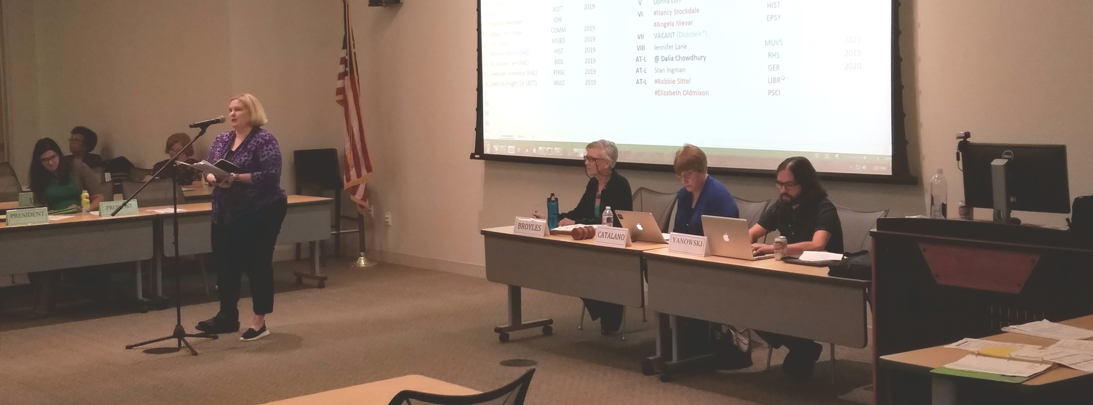

Slide 2
Charter of the Faculty Senate - Article I. Role and Competence of the Faculty Senate
The Faculty Senate ADVOCATES FOR SHARED GOVERNANCE, and in doing so encourages faculty to participate and discuss academic matters to ensure that academic quality remains a priority at UNT...
The Senate REPRESENTS THE VIEW OF THE FACULTY to the UNT Administration.
The Faculty Senate MAY CONSIDER ALL MATTERS OF GENERAL WELFARE to the university including matters raised by senators, by senate committees and by the president of the university...

Slide 3

Leadership
Officers
Chair, Vice Chair and Secretary
Elected in May for one-year term beginning July 1
Executive Committee
Vice Chair is Chair of the Executive Committee
Three officers, the immediate-past Chair, and one Senator representative from each voting group
Meetings held first and last Wednesdays of the month (end of August through beginning of June)

Slide 4
Faculty Senate Membership
50 faculty senators elected by all eligible full-time faculty in spring elections
Apportioned among 8 voting groups based upon department, as provided for in the Charter; reapportioned every three years
10 elected at-large from among the various tenured and professional full-time faculty ranks
Three-year terms, maximum two consecutive terms (begin at September Faculty Senate meeting)
2 non-voting student senators serving one-year terms
Meetings are held the second Wednesday of each month (September through June, except no meeting in January)

Slide 5
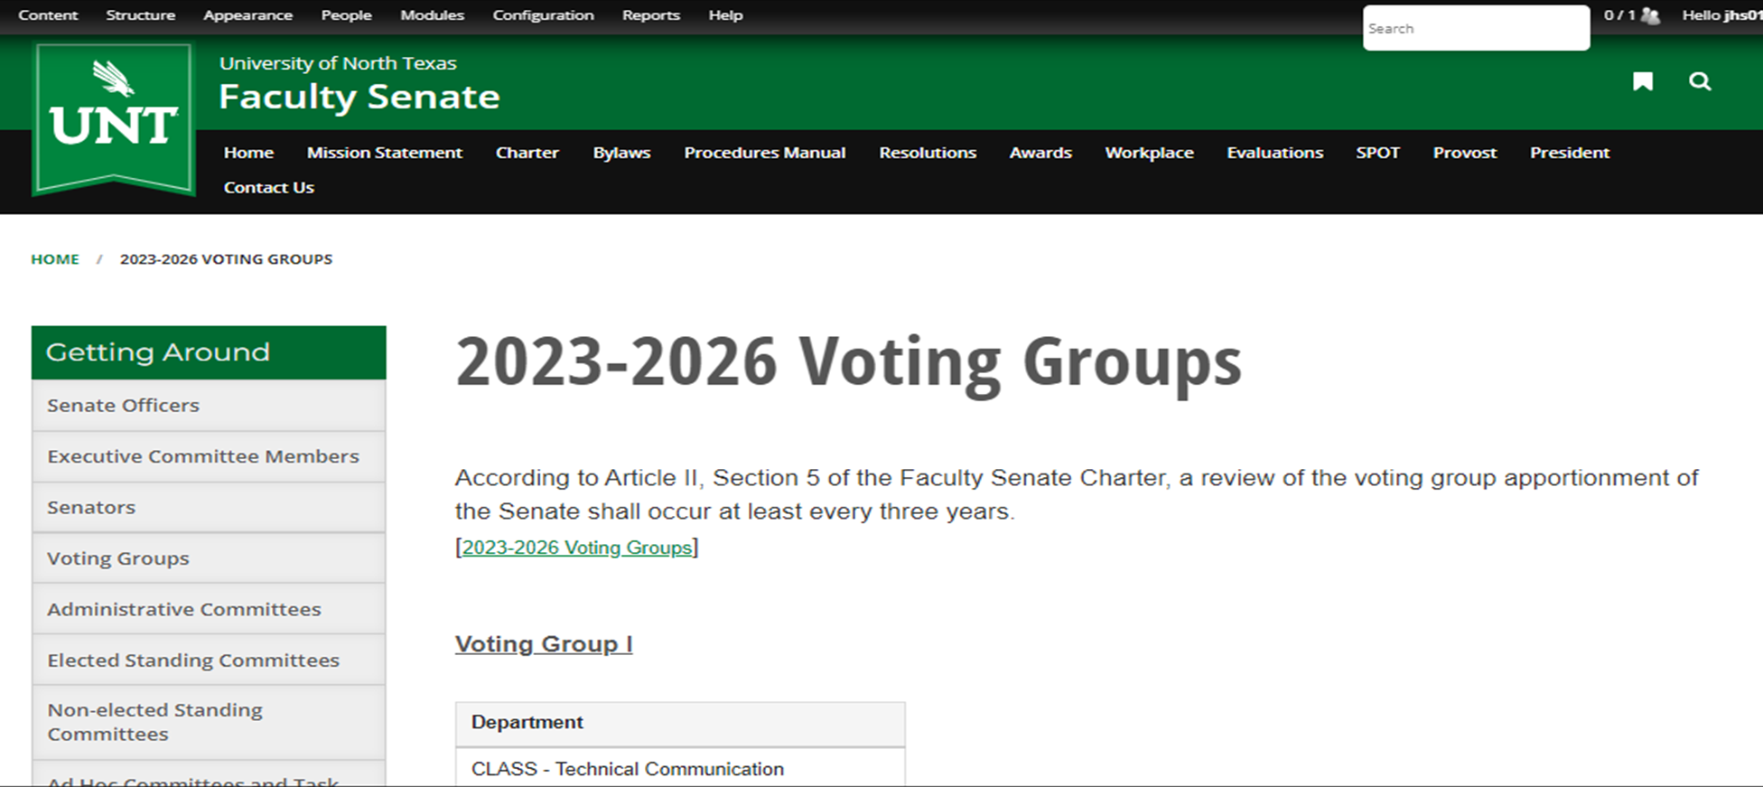
Voting Group affiliations may be viewed at the Faculty Senate website: https://FacultySenate.unt.edu

Slide 6
Additional information found on the Faculty Senate website:
List of voting group affiliations
Officers page
List of Senators
Executive Committee members page
Senate meeting schedule
Meeting agendas, minutes and recordings
Standing committee pages and reports
Administrative committee Senate appointees
Resolutions and Policies information
UNT faculty salary data
Administrator evaluation results

Slide 7

Committee Participation
Non-Elected Standing Committees
Twenty-five committees
Filled through a Senate nominations and approval process
Some have eligibility requirements – review the Procedures Manual or committee page found on the Faculty Senate website
Elected Standing Committees
Three committees: Graduate Council, Faculty Development Leave Committee, and University Faculty Grievance Committee
Must follow election process rules to nominate and vote for candidates
Administrative Committees
Not administered by the Senate
Approximately twenty committees currently
Filled in various ways (mostly via nominations/FS approval but some special chair appointments)
Some have eligibility requirements – review committee page found on the Faculty Senate website or contact the administering entity

Slide 8
Committee Participation
Information about each committee – including a list of members and vacancies – may be found on the Faculty Senate website https://facultysenate.unt.edu/
To submit a nomination for yourself or another faculty member for a non-elected standing committee or administrative committee vacancy, send an email with the committee’s name, nominee’s name, and nominee’s department affiliation to the Faculty Senate office at facultysenate@unt.edu or contact a Senator or colleague to submit it for you.

Slide 9
We are committed to:
Communication
Collaboration
Advocacy
Transparency

Slide 10

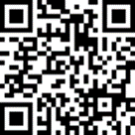
Contact the Faculty Senate
Coby Condrey, chair
coby.condrey@unt.edu
William Joyner, vice chair
william.joyner@unt.edu
Sarah Evans, secretary
sarah.evans@unt.edu
UNT Faculty Senate
https://facultysenate.unt.edu
Hurley Building 116
facultysenate@unt.edu
940-565-2053
Jill Stover, administrative coordinator

