Slide 1
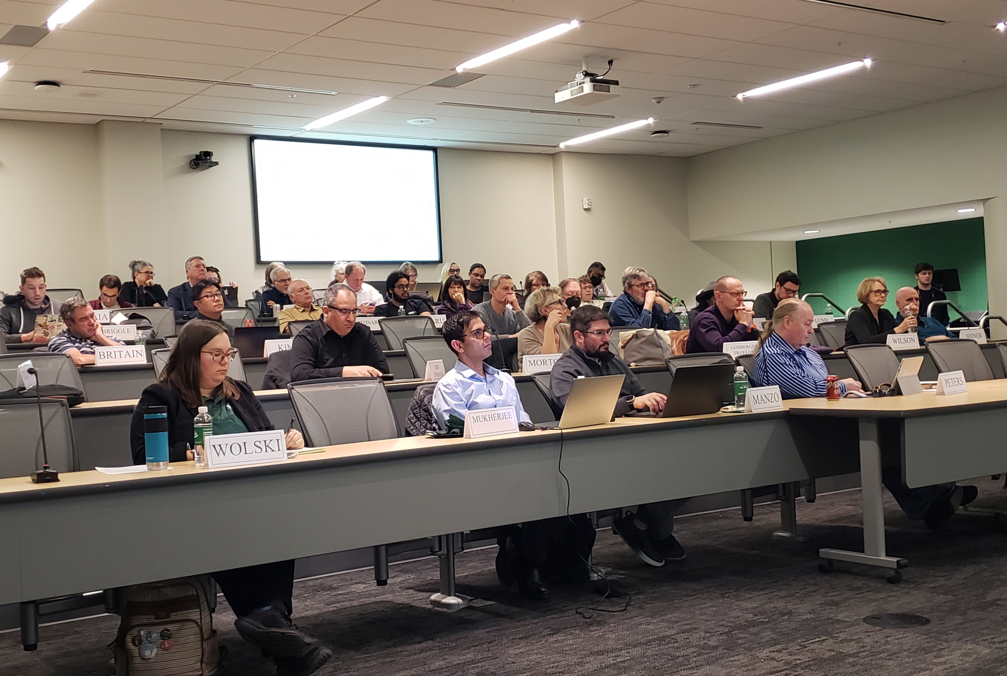

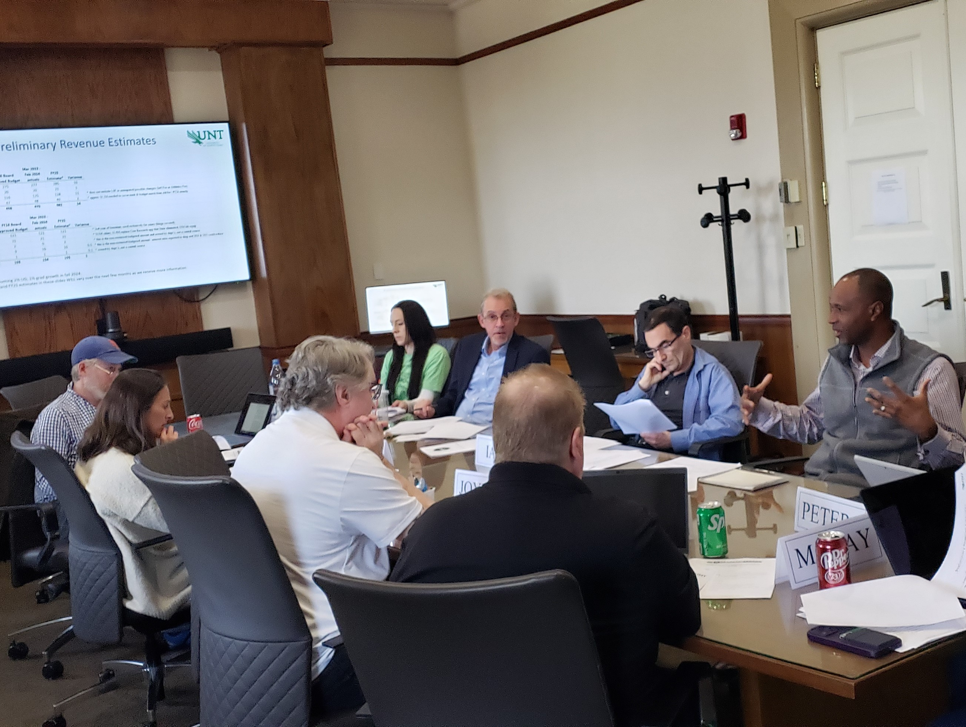



Slide 2
Charter of the Faculty Senate
The Faculty Senate advocates for shared governance, and in doing so encourages faculty to participate and discuss academic matters to
ensure that academic quality remains a priority at UNT.
The Faculty Senate represents the view of the faculty to the UNT Administration.
The Faculty Senate may consider all matters of general welfare to the university including matters raised by senators, by senate committees and by the president of the university, and [others].

Slide 3
Faculty Senate Membership 2026-2027
54 senators from all ranks and colleges (maximum 60 allowed)
Presidential appointment of one senator per college
Election of senators from 8 voting groups (voting groups determined by an apportionment process and approved by the Senate)
Election of at-large senators from among all full-time faculty ranks
Two student senators (non-voting)

Slide 4
Leadership
Officers
Chair, Vice Chair and Secretary
Appointed by President
One-year terms beginning July 1
Executive Committee
Members: three officers, the immediate-past chair,
and eight other senators
Vice Chair is Chair of the Executive Committee
Purpose: Planning for Faculty Senate's monthly
general sessions
Meets twice per month except in summer

Slide 5

Meetings & Business
General Sessions
Second Wednesdays at 2 pm, Union 332 (usually)
September – December & February – June
Includes …
  University Update (President & Provost)
  Topical presentations
  Committee reports and updates
Open to public & viewable by livestream
Suggest business to a senator or contact FacultySenate@unt.edu
Schedule, agendas, minutes, and recordings available on Faculty Senate website

Slide 6
Committee Participation
Non-Elected Standing Committees
Twenty committees
Filled through a Senate nominations and approval process
Some have eligibility requirements – review the committee pages found on the Faculty Senate website
Elected Standing Committees
Three committees: Graduate Council, Faculty Development Leave Committee, and University Faculty Grievance Committee
Must follow election process rules to nominate and vote for candidates
Administrative Committees
Not administered by the Senate
Approximately twenty committees currently
Filled in various ways (mostly via nominations/FS approval but some special chair appointments)
Some have eligibility requirements – review committee page found on the Faculty Senate website or contact the administering entity

Slide 7

Committee Participation
Information about each committee – including a list of members and vacancies – may be found at https://facultysenate.unt.edu/
To submit a nomination for yourself or another faculty member:
Send an e-mail with the committee name, nominee's name, and nominee's department affiliation to the Faculty Senate office at FacultySenate@unt.edu.
Ask one of your voting group, college or at-large senators to submit your nomination

Slide 8
Faculty Senate Website Resources
Directory of Senators and Executive Committee members
Meeting schedules, agendas, minutes and recordings
Standing committee pages and reports
Administrative committee Senate appointees
Awards processes managed by the Faculty Senate
Mission, charter, bylaws, procedures manual & resolutions
Policies under review
UNT faculty salary data
Administrator evaluation results

Slide 9
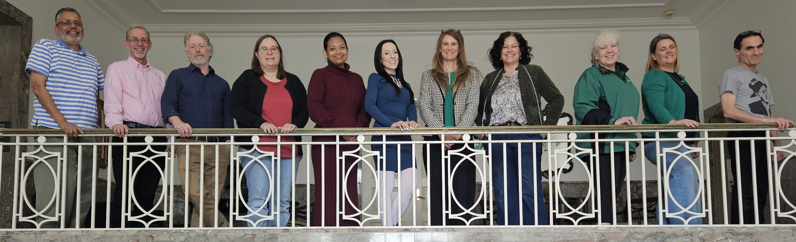
We are committed to:
Collaboration
Communication
Advocacy
Transparency

Slide 10
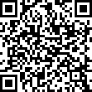

Contact the Faculty Senate
Adam Chamberlin, chair
Adam.Chamberlin@unt.edu
Melissa McKay, vice chair
Melissa.McKay@unt.edu
Rose Baker, secretary
Rose.Baker@unt.edu
UNT Faculty Senate
https://facultysenate.unt.edu
Hurley Building 116
FacultySenate@unt.edu
940-565-2053
Jill Stover, administrative coordinator
Aryan Patial, office assistant

